Slide 1

John’s super quiz
VE day special
with absolutely no questions about any war

Slide 2
Round 1
Multi Choice

Slide 3
Question 1
How long can female lice have sex for?
10 hours
30 hours
50 hours
70 hours

Slide 4
Question 2
How long does it take a spacecraft to get into space?
6.5 mins
8.5 mins
10.5 mins
15.5 mins

Slide 5
Question 3
Mahnà Mahnà, the song made famous by The Muppets, was originally composed for;
Sesame Street
The James Brown band The Furious Five
The film Animal House
An X-rated Italian film

Slide 6
Question 4
Which of these is NOT a hiking highlight in New Zealand;
Maori Knob
Bob’s Knob
Nervous Knob
Bonar Knob

Slide 7
Question 5
The Chinese word for penguin (企鵝) translate literally as;
Upright goose
Walking duck
No fly bird
Swimming bird

Slide 8
Question 6
In Italy, it is illegal to build a home without;
Solar panels
A front door that opens outward
A porch
A bidet

Slide 9
Question 7
Globally, what category of drinks outsells all others combined;
Coffee
Tea
All soft drinks combined
All alcohol combined

Slide 10
Question 8
The Parliament of New Zealand maintains a list of insults banned by the Speaker. Which one of these is not on the list?
His brains could revolve inside a peanut shell for a thousand years without touching the sides
Energy of a tired snail returning home from funeral
If I gave him half a brain, he’d be a halfwit
Duck shoving

Slide 11
Question 9
The first iPhone virus was the Ikee worm which infected thousands of Australian iPhones. Its only function was to change the phone’s wallpaper to a picture of
A Kangaroo
Kylie Minogue
Rick Astley
Katie Price and Alex Reid

Slide 12
Question 10
Déjà-rêvé is the feeling that you're experiencing something that you have previously …
Read about or seen in a film
Dreamt about
Been told about
Thought about while sat on the lavatory

Slide 13
Round 2
True or False

Slide 14
Question 11
True or False?
Australia has the most arachnophobic people per capita.

Slide 15
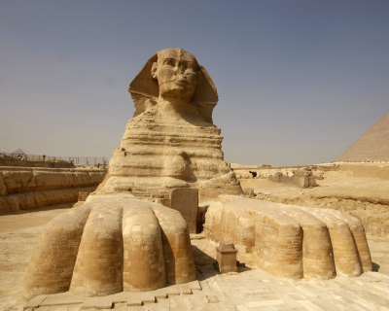
Question 12
True or False?
The great phoenix at giza has a tail.

Slide 16
Question 13
True or False?
In the 1960s New York City had a mobile swimming pool that could be driven into neighborhoods?

Slide 17
Question 14
True or False?
The hamlet of Ham in Kent, is located near to the town of Sandwich.

Slide 18
Question 15
True or False?
Goldfish have a memory of 3 seconds

Slide 19
Question 16
True or False?
A man in Ohio once invented a goat powered vehicle
(There had to be a goat question)

Slide 20
Question 17
True or False?
You scroll about ten miles a year.

Slide 21
Question 18
True or False?
In 2018, more people were killed in the USA by lettuce than by snakes and alligators combined

Slide 22
Question 19
True or False?
The name of every odd number contains the letter e.

Slide 23
Question 20
True or False?
Two men were arrested in Florida while carrying bags full of drugs with the words ‘Bag Full of Drugs’ written on them.

Slide 24
Round 3
Short break?
Images

Slide 25
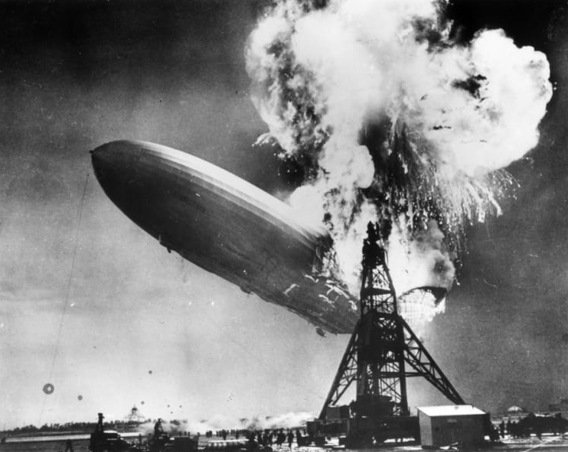
Question 21
What is the name of this air ship

Slide 26
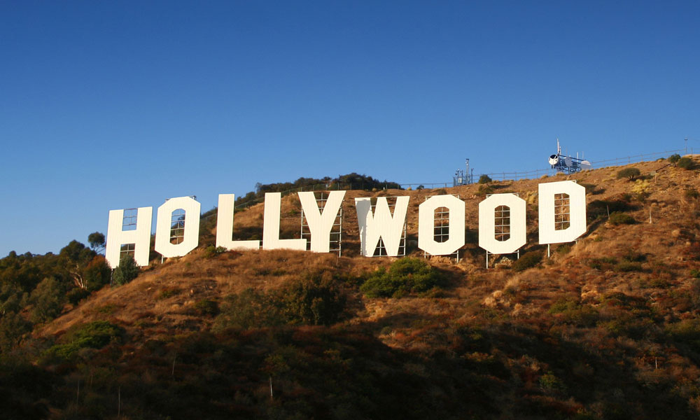
Question 22
What did
this famous
sign
originally
say

Slide 27
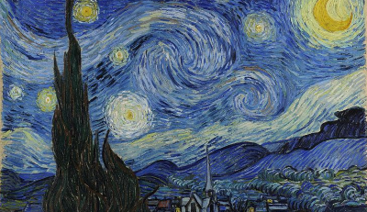
Question 23
Who painted The Starry Night

Slide 28
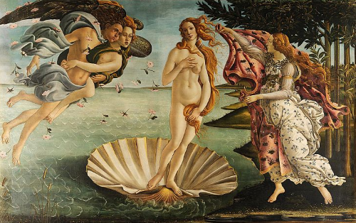
Question 24
Who painted The Birth of Venus

Slide 29
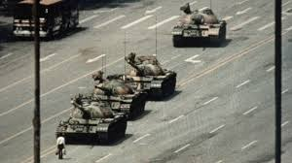
Question 25
Where was this photo taken

Slide 30
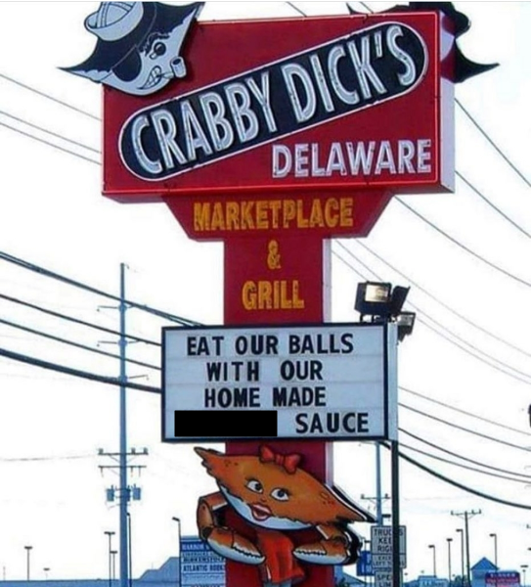
Question 26
What is the missing
word

Slide 31
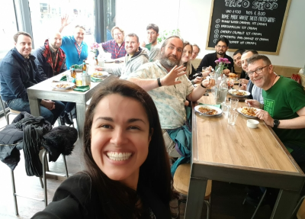
Question 27
Where was
this photo
taken

Slide 32
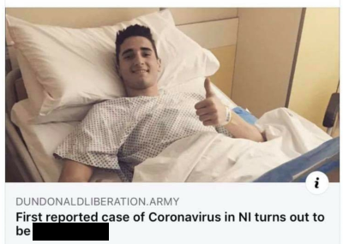
Question 28
What’s
missing

Slide 33
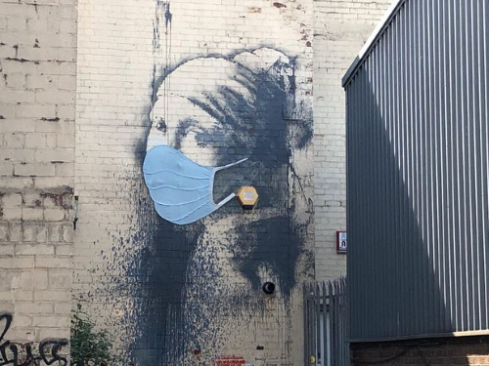
Question 29
Who is
the
artist

Slide 34
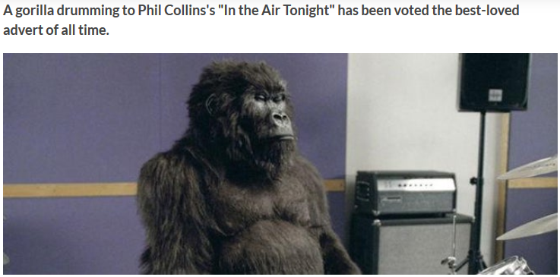
Question 30
What was this advertising

Slide 35
Round 4
Any other business

Slide 36
Question 31
Which of the planets was originally called George?

Slide 37
Question 32
What is the English language equivalent of these phrases?
Albanian "God is having a piss“
Colombian Spanish "raining husbands“
Welsh "raining old ladies and sticks
Greece "raining chair legs"

Slide 38
Question 33
What is a NAMELING?

Slide 39
Question 34
Which European country has a province, a city and a river all called Batman.

Slide 40
Question 35
According to studies; what profanity do women say ten times more often than men do.

Slide 41
Question 36
Syndactyly is the medical term for what?

Slide 42
Question 37
If you read five items from the British Library every day, how many years would it take you to get through them all?
80
800
8,000
80,000

Slide 43
Question 38
True or False
Banana is a berry.

Slide 44
Question 39
True or False
Banana is a herb.

Slide 45
Question 40
True or False
Banana plants can walk 40cm in their lifetime

Slide 46
Time for a break
That’s the end of the quiz

Slide 47
Answers

Slide 48
Answer 1
How long can female lice have sex for?
10 hours
30 hours
50 hours
70 hours

Slide 49
Answer 1
How long can female lice have sex for?
10 hours
30 hours
50 hours
70 hours

Slide 50
Answer 2
How long does it take a spacecraft to get into space?
6.5 mins
8.5 mins
10.5 mins
15.5 mins

Slide 51
Answer 2
How long does it take a spacecraft to get into space?
6.5 mins
8.5 mins
10.5 mins
15.5 mins

Slide 52
Answer 3
Mahnà Mahnà, the song made famous by The Muppets, was originally composed for;
Sesame Street
The James Brown band The Furious Five
The film Animal House
An X-rated Italian film

Slide 53
Answer 3
Mahnà Mahnà, the song made famous by The Muppets, was originally composed for;
Sesame Street
The James Brown band The Furious Five
The film Animal House
An X-rated Italian film

Slide 54
Answer 4
Which of these is NOT a hiking highlight in New Zealand;
Maori Knob
Bob’s Knob
Nervous Knob
Bonar Knob

Slide 55
Answer 4
Which of these is NOT a hiking highlight in New Zealand;
Maori Knob
Bob’s Knob
Nervous Knob
Bonar Knob

Slide 56
Answer 5
The Chinese word for penguin (企鵝) translate literally as;
Upright goose
Walking duck
No fly bird
Swimming bird

Slide 57
Answer 5
The Chinese word for penguin (企鵝) translate literally as;
Upright goose
Walking duck
No fly bird
Swimming bird

Slide 58
Answer 6
In Italy, it is illegal to build a home without;
Solar panels
A front door that opens outward
A porch
A bidet

Slide 59
Answer 6
In Italy, it is illegal to build a home without;
Solar panels
A front door that opens outward
A porch
A bidet

Slide 60
Answer 7
Globally, what category of drinks outsells all others combined;
Coffee
Tea
All soft drinks combined
All alcohol combined

Slide 61
Answer 7
Globally, what category of drinks outsells all others combined;
Coffee
Tea
All soft drinks combined
All alcohol combined

Slide 62
Answer 8
The Parliament of New Zealand maintains a list of insults banned by the Speaker. Which one of these is not on the list?
His brains could revolve inside a peanut shell for a thousand years without touching the sides
Energy of a tired snail returning home from a funeral
If I gave him half a brain, he’d be a halfwit
Duck shoving

Slide 63
Answer 8
The Parliament of New Zealand maintains a list of insults banned by the Speaker. Which one of these is not on the list?
His brains could revolve inside a peanut shell for a thousand years without touching the sides
Energy of a tired snail returning home from a funeral
If I gave him half a brain, he’d be a halfwit
Duck shoving

Slide 64
Answer 9
The first iPhone virus was the Ikee worm which infected thousands of Australian iPhones. Its only function was to change the phone’s wallpaper to a picture of
A Kangaroo
Kylie Minogue
Rick Astley
Katie Price and Alex Reid

Slide 65
Answer 9
The first iPhone virus was the Ikee worm which infected thousands of Australian iPhones. Its only function was to change the phone’s wallpaper to a picture of
A Kangaroo
Kylie Minogue
Rick Astley
Katie Price and Alex Reid

Slide 66
Answer 10
Déjà-rêvé is the feeling that you're experiencing something that you have previously …
Read about or seen in a film
Dreamt about
Been told about
Thought about while sat on the lavatory

Slide 67
Answer 10
Déjà-rêvé is the feeling that you're experiencing something that you have previously …
Read about or seen in a film
Dreamt about
Been told about
Thought about while sat on the lavatory

Slide 68
Answer 11
True or False?
Australia has the most arachnophobic people per capita.

Slide 69
Answer 11
True or False?
Australia has the most arachnophobic people per capita.
FALSE

Slide 70
Answer 11
Explanation.
A PHOBIA is an extreme or irrational fear of or aversion to something.
Irrational means not logical or reasonable.
Australia has 8 of the worlds most deadly spiders, so there is nothing irrational about it.

Slide 71
Answer 12
True or False?
The great phoenix at giza has a tail.

Slide 72
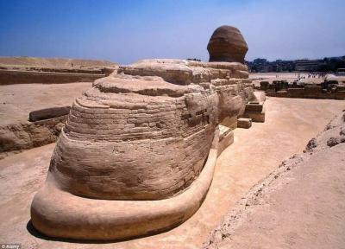
Answer 12
True or False?
The great phoenix at giza has a tail.
TRUE

Slide 73
Answer 13
True or False?
In the 1960s New York City had a mobile swimming pool that could be driven into neighborhoods?

Slide 74
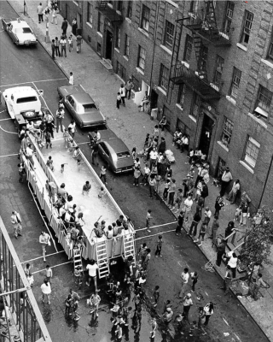
Answer 13
True or False?
In the 1960s New York City had a mobile swimming pool that could be driven into neighbourhoods?
TRUE

Slide 75
Answer 14
True or False?
The hamlet of Ham in Kent, is located near to the town of Sandwich.

Slide 76
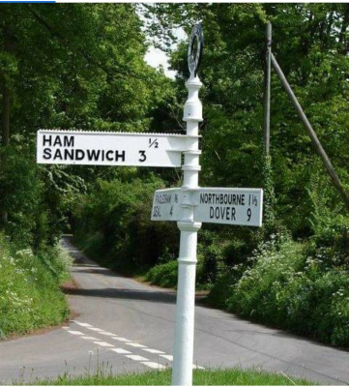
Answer 14
True or False?
The hamlet of Ham in Kent, is located near to the town of Sandwich.
TRUE

Slide 77
Answer 15
True or False?
Goldfish have a memory of 3 seconds

Slide 78
Answer 15
True or False?
Goldfish have a memory of 3 seconds
FALSE
Scientists have shown that their memories can last for months

Slide 79
Question 16
True or False?
A man in Ohio once invented a goat powered vehicle

Slide 80
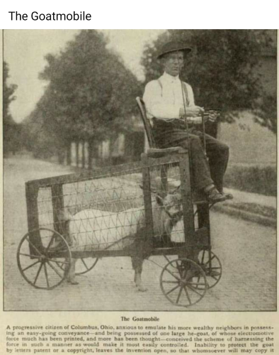
Question 16
True or False?
A man in Ohio once invented a goat powered vehicle
TRUE

Slide 81
Answer 17
True or False?
You scroll about ten miles a year.

Slide 82
Answer 17
True or False?
You scroll about ten miles a year.
FALSE
You scroll about five miles a year.

Slide 83
Answer 18
True or False?
In 2018, more people were killed in the USA by lettuce than by snakes and alligators combined

Slide 84
Answer 18
True or False?
In 2018, more people were killed in the USA by lettuce than by snakes and alligators combined
TRUE

Slide 85
Answer 19
True or False?
The name of every odd number contains the letter e.

Slide 86
Answer 19
True or False?
The name of every odd number contains the letter e.
TRUE

Slide 87
Answer 20
True or False?
Two men were arrested in Florida while carrying bags full of drugs with the words ‘Bag Full of Drugs’ written on them.

Slide 88
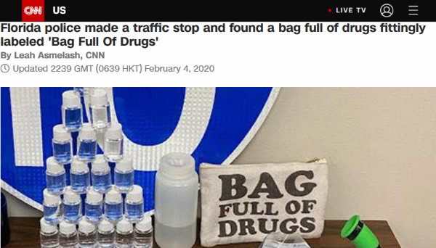
Answer 20
True or False?
Two men were arrested in Florida while carrying bags full of drugs with the words ‘Bag Full of Drugs’ written on them.
TRUE
February 4th 2020

Slide 89
Answer 21
What is the name of this air ship

Slide 90
Answer 21
What is the name of this air ship
Hindenburg

Slide 91
Answer 22
What did
this famous
sign
originally
say

Slide 92
Answer 22
What did
this famous
sign
originally
say
HOLLYWOODLAND

Slide 93
Answer 23
Who painted The Starry Night

Slide 94
Answer 23
Who painted The Starry Night
Vincent Van Gogh

Slide 95
Answer 24
Who painted The Birth of Venus

Slide 96
Answer 24
Who painted The Birth of Venus
Sandro Botticelli

Slide 97
Answer 25
Where was this photo taken

Slide 98
Answer 25
Where was this photo taken
Tiananmen square

Slide 99
Answer 26
What is the missing
word

Slide 100
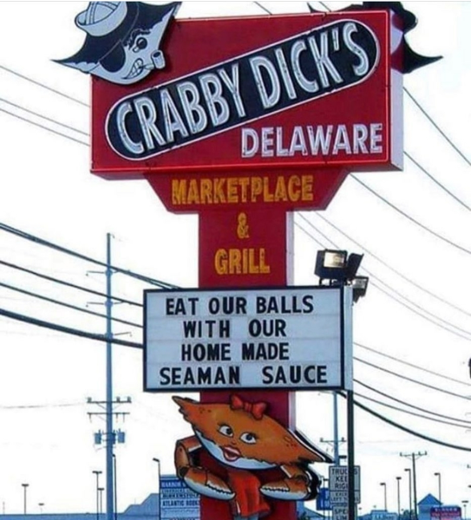
Answer 26
What is the missing
word.
I’m sorry

Slide 101
Answer 27
Where was
this photo
taken

Slide 102
Answer 27
Where was
this photo
taken
Brewski Bar

Slide 103
Answer 28
What’s
missing

Slide 104
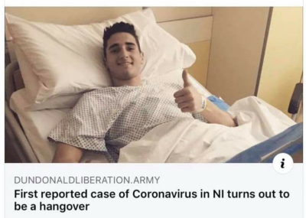
Answer 28
What’s
missing

Slide 105
Answer 29
Who is
the
Artist

Slide 106
Answer 29
Who is
the
Artist
Banksy
probably

Slide 107
Answer 30
What was this advertising

Slide 108
Answer 30
What was this advertising
Cadbury's Dairy Milk

Slide 109
Answer 31
Which of the planets was originally called George?

Slide 110
Answer 31
Which of the planets was originally called George?
Uranus

Slide 111
Answer 32
What is the English language equivalent of this phrases?
Albanian "God is having a piss“
Colombian Spanish "raining husbands“
Welsh "raining old ladies and sticks
Greece "raining chair legs"

Slide 112
Answer 32
What is the English language equivalent of this phrases?
Albanian "God is having a piss“
Colombian Spanish "raining husbands“
Welsh "raining old ladies and sticks
Greece "raining chair legs"
"it's raining cats and dogs"

Slide 113
Answer 33
What is a NAMELING?

Slide 114
Answer 33
What is a NAMELING?
A NAMELING is someone who shares your name

Slide 115
Answer 34
Which European country has a province, a city and a river all called Batman.

Slide 116
Answer 34
Which European country has a province, a city and a river all called Batman.
Turkey

Slide 117
Answer 35
According to studies; what profanity do women say ten times more often than men do.

Slide 118
Answer 35
According to studies; what profanity do women say ten times more often than men do.
Shit

Slide 119
Answer 36
Syndactyly is the medical term for what?

Slide 120
Answer 36
Syndactyly is the medical term for what?
Webbing of the fingers or toes

Slide 121
ANSWER 37
If you read five items from the British Library every day, how many years would it take you to get through them all?
80
800
8,000
80,000

Slide 122
ANSWER 37
If you read five items from the British Library every day, how many years would it take you to get through them all?
80
800
8,000
80,000

Slide 123
Answer 38
True or False
Banana is a berry.

Slide 124
Answer 38
True or False
Banana is a berry.
TRUE

Slide 125
ANSWER 39
True or False
Banana is a herb.

Slide 126
ANSWER 39
True or False
Banana is a herb.
TRUE

Slide 127
Answer 40
True or False
Banana plants can walk 40cm in their lifetime

Slide 128
Answer 40
True or False
Banana plants can walk 40cm in their lifetime
TRUE

Slide 129
Thank you

